Slide 1
CH6 分治法(Divide and Conquer) 二元搜尋法(Binary Search)

Slide 2
Divide & Conquer
分治法 / 各個擊破法

Slide 3
分治法(Divide and Conquer)
Divide (top-down)
把大問題切割成二或多個小問題
Conquer (bottom-up)
把小問題的解答組合成大問題的解答
Recursion (遞迴) 就是分治法的一種
但有些問題利用分治法來解題, 可能效率不好
切割出來的子問題跟原本的問題複雜度差不多
子問題衍生出太多重複計算
各個擊破 !

Slide 4
分割農地
有一位農夫想把他的農地分割成數塊「正方形」的農地, 但又希望每塊農地的面積越大越好
L = 1680, W = 640

Slide 5


分割農地 歐幾里德演算法(Euclid’s Algorithm)
L = 1680
W = 640
while L % W != 0:
L, W = W, L%W
print(W)
640
Output: 80
640
640
400
400
240

Slide 6
Sum of a list
index | 0 | 1 | 2 | 3 | 4 | 5
num | 2 | 4 | 6 | 8 | 10 | 12
# recursion
num = [2, 4, 6, 8, 10, 12]
def mySum(lst):
if len(lst) == 1:
return lst[0]
else:
return lst.pop() + mySum(lst)
print(mySum(num))
# iterative
num = [2, 4, 6, 8, 10, 12]
Sum = 0
for n in num:
Sum += n
print(Sum)

Slide 7
N! (階乘)
N = 1000
# solution 1 - iterative
ans = 1
for i in range(2, N+1):
ans *= i
print(ans)
#solution2 – divide & conquer (recursion)
def F(n):
if n == 1:
return 1
else:
return n * F(n-1)
print(F(N))
1000!
= 1000 x 999 x 998 x … x 3 x 2 x 1
= 1000 x 999!

Slide 8
F(4) = 4! (階乘)
1
F(4)
2
8
24
F(4):
Ans = 4 * F(3)
F(3):
Ans = 3 * F(2)
3
7
6
F(2):
Ans = 2 * F(1)
4
6
2
F(1):
return 1
5
1

Slide 9
F(3) = 3! (階乘)
Call stack
F(3)
if n == 1:
else:
return 3 * F(2)
----------------------
F(2)
if n == 1:
else:
return 2 * F(1)
----------------------
F(1)
1f n == 1:
return 1
F
n
3
def F(n):
if n == 1:
return 1
else:
return n * F(n-1)
F
n
2
F
n
3
6
F
n=3
n
1
F
n
2
2
F
n=2
n
3
F
n
1
回傳1
1
F
n=1
n
2
F
n
3

Slide 10
不適合使用分治法的問題 – 費氏數列
﻿計算F(20)
Solution-1 (iterative): 7e-05
Solution-2 (recursion): 265e-05
﻿計算F(200)
Iterative: 200 ns (假設)
Recursion: 4 x 10¹³ years (等效)
N = 20
# solution 1 - iterative
F0, F1 = 0, 1
for i in range(2, N+1):
F1, F0 = F1+F0, F1
print(F1)
#solution 2 - recursion
def F(n):
if n <= 1:
return n
else:
return F(n-1) + F(n-2)
print(F(N))

Slide 11
費氏數列 - recursion
有很多重複的計算
O(2^{n/2})

Slide 12
計算 (a ** b) % c
a = 12321
b = 999
c = 1234
# solution 1 - iterative
ans = a
for i in range(1, b):
ans *= a
print(ans % c)
#solution 2 - recursion
def F(a, b, c):
if b == 1:
return a % c
if b % 2 == 0:
return (F(a, b//2, c) ** 2) % c
else:
return (a * (F(a, b//2, c) ** 2)) % c
print(F(a, b, c))
計算1000!
Solution-1: 56e-05
Solution-2: 8e-05

Slide 13
Quick Sort
3 | 5 | 2 | 6 | 1 | 4
quickSort([3, 5, 2, 6, 1, 4])
pivot
3 | 2 | 1
4
5 | 6
quickSort([3, 2, 1]) + [4] + quicksort([5, 6])
pivot
1
3 | 2
4
5 | 6
quickSort([3, 2, 1]) + [4] + quicksort([5, 6])
= [1] + quickSort([3, 2]) + [4] + quicksort([5, 6])
pivot
1
2
3
4
5 | 6
1 | 2 | 3 | 4
5
6
pivot

Slide 14
Quick Sort
﻿def quickSort(lst):
if len(lst) < 2:
return lst
else:
pivot = lst.pop()
left = []
right = []
for n in lst:
if n <= pivot:
left.append(n)
else:
right.append(n)
return quickSort(left) + [pivot] + quickSort(right)
print(quickSort([3, 5, 2, 6, 1, 4]))
﻿Output: [1, 2, 3, 4, 5, 6]

Slide 15
Merge Sort (動畫演示)
def merge(start, mid, end):
#if the direct merge is already sorted
if arr[mid] <= arr[mid+1]:
return
# Two pointers to maintain start of both arrays to merge
start2 = mid + 1
while (start <= mid) and (start2 <= end):
if arr[start] <= arr[start2]:
start += 1
else:
value = arr[start2]
arr.pop(start2)
arr.insert(start, value)
start += 1
mid += 1
start2 += 1
def mergeSort(l, r):
if l < r:
m = (l + r) // 2
#Sort first and second halves
mergeSort(l, m)
mergeSort(m + 1, r)
merge(l, m, r)
# main program
arr = [12, 11, 13, 5, 6, 7]
mergeSort(0, len(arr) - 1)
print(arr)

Slide 16
Tower of Hanoi (河內塔)
Pillar-A Pillar-B Pillar-C
Disk
1
2
3
4

Slide 17
Tower of Hanoi (河內塔)
﻿def Hanoi(n, src, dst, tmp):
global move
if n != 0:
Hanoi(n-1, src, tmp, dst)
move += 1
print(f"(Move-{move:2d}) Disk-{n} from "
f"pillar-{src} to pillar-{dst}")
Hanoi(n-1, tmp, dst, src)
# main program
move = 0
Hanoi(4, 'A', 'C', 'B')

Slide 18
Tower of Hanoi (河內塔)
(1)
(2)
(3)
(Move- 1) Disk-1 from pillar-A to pillar-B
(Move- 2) Disk-2 from pillar-A to pillar-C
(Move- 3) Disk-1 from pillar-B to pillar-C
(Move- 4) Disk-3 from pillar-A to pillar-B
(Move- 5) Disk-1 from pillar-C to pillar-A
(Move- 6) Disk-2 from pillar-C to pillar-B
(Move- 7) Disk-1 from pillar-A to pillar-B
(Move- 8) Disk-4 from pillar-A to pillar-C
(Move- 9) Disk-1 from pillar-B to pillar-C
(Move-10) Disk-2 from pillar-B to pillar-A
(Move-11) Disk-1 from pillar-C to pillar-A
(Move-12) Disk-3 from pillar-B to pillar-C
(Move-13) Disk-1 from pillar-A to pillar-B
(Move-14) Disk-2 from pillar-A to pillar-C
(Move-15) Disk-1 from pillar-B to pillar-C
(4)
(5)
(6)
(7)
(8)
(9)
(10)
(11)
(12)
(13)
(14)
(15)

Slide 19
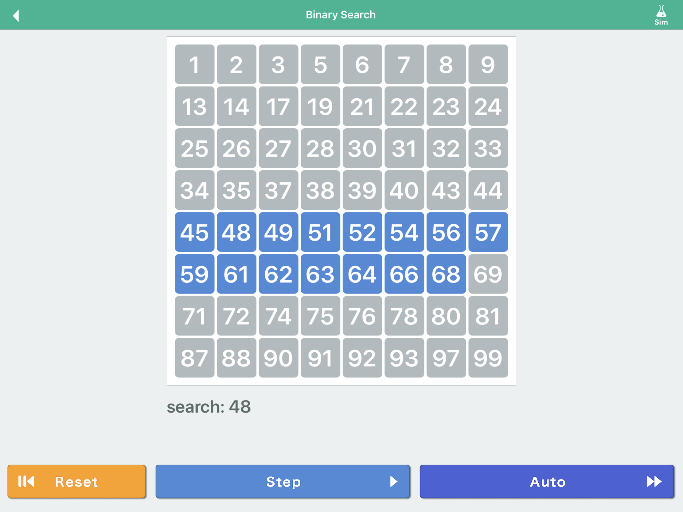
Binary Search (動畫演示)

Slide 20
二元搜尋法(Binary Search)
把問題搜尋的範圍, 每次縮小一半, 加快逼近答案, 效率很高
也可用於找出最佳解
搜尋前, 資料要先排序

Slide 21
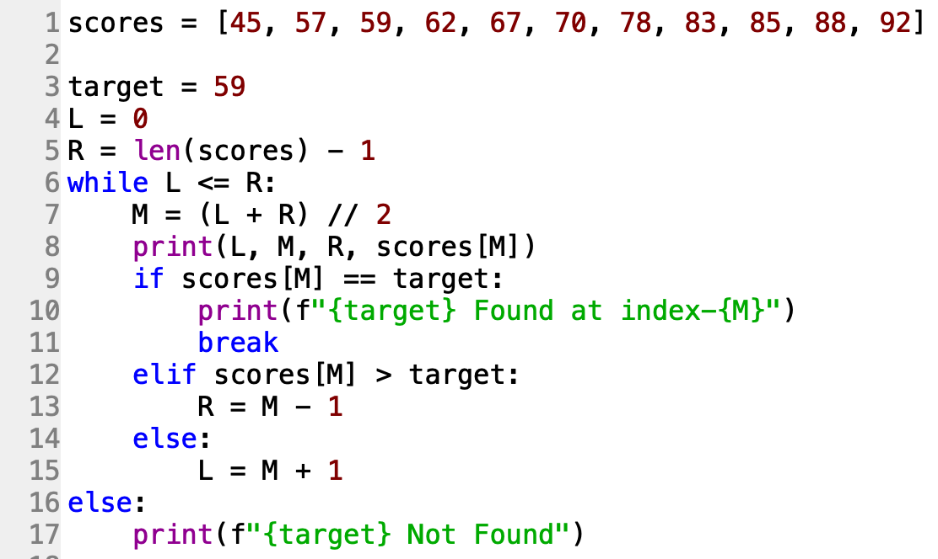
使用Binary Search搜尋資料
0 5 10 70
0 2 4 59
59 Found at index-2

Slide 22
分配糖果
有n包不同口味的糖果要分給m個小朋友, 每包糖果的數量不同, 每個小朋友只接受同一口味的糖果, 小朋友只在乎數量是否一樣, 可以任意給同一口味的糖果, 若某包糖果數量較多, 就可以分給多個小朋友, 多出的可以不分配, 若某包糖果數量太少導致不能分配出去, 可要求每個小朋友最多可以拿幾顆糖果.
輸入說明: 輸入n表示會輸入n包不同口味的糖果, 接著輸入n行, 每一行 一個數字,表示該包糖果的數量, 接著輸入m, 表示有幾個小朋友.
max
candies = [10, 21, 16, 40, 55, 45, 35, 54, 33, 46]
low = 0, mid = 27, high = 55 → 9
low = 0, mid = 13, high = 26 → 23
low = 14, mid = 20, high = 26 → 13
low = 21, mid = 23, high = 26 → 10
23

Slide 23
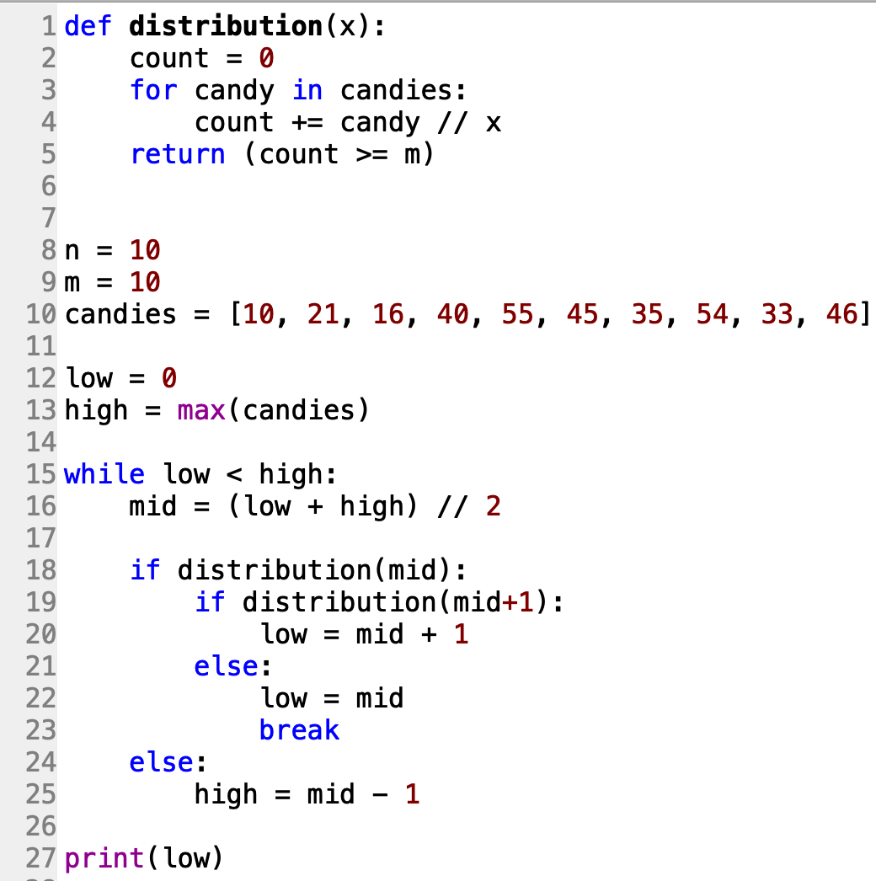
Output:
23

Slide 24
APCS 10603 第4題 基地台
https://zerojudge.tw/ShowProblem?problemid=c575
def test(x):
count = 1
end = P[0] + x
for p in P:
if p <= end:
pass
else:
end = p + x
count += 1
if count <= K:
return True
else:
return False
while True:
try:
N, K = map(int, input().strip().split())
P = list(map(int, input().strip().split()))
P = sorted(list(set(P)))
L = 1
R = (P[-1] - P[0]) // K + 1
while L < R:
M = (L + R) // 2
if test(M):
R = M
else:
L = M + 1
print(R)
except:
break

Slide 25
Exercise: UVa Challenges
c002: 10696 - f91
https://zerojudge.tw/ShowProblem?problemid=c002
d636: 大爆炸bomb
https://zerojudge.tw/ShowProblem?problemid=d636
d613: Prime Gap
https://zerojudge.tw/ShowProblem?problemid=d613
00374 - Big Mod
https://onlinejudge.org/index.php?option=com_onlinejudge&Itemid=8&page=show_problem&problem=310
(TLE) 11495 - Bubbles and Buckets
https://zerojudge.tw/ShowProblem?problemid=d195

